Slide 1
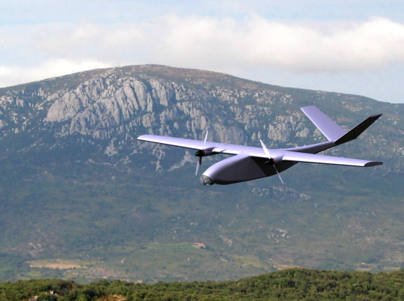
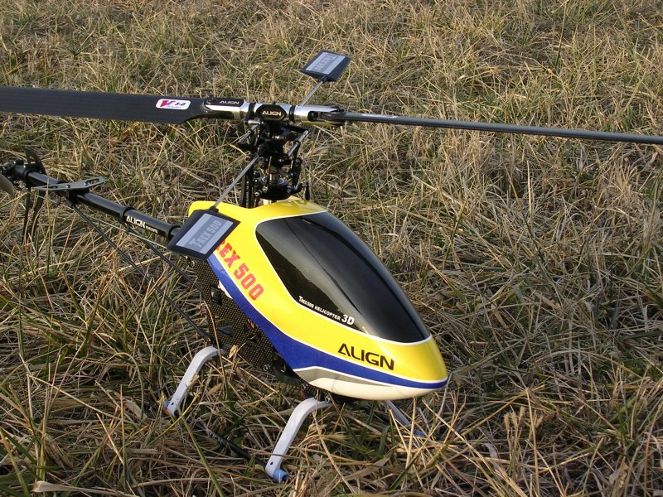
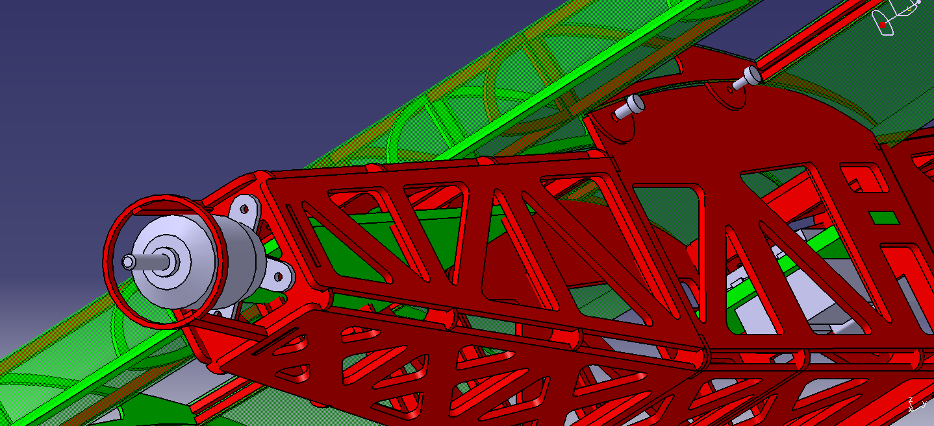
STUDENT ORGANIZATIONS
OF AVIATION
Rzeszow University of Technology

Slide 2
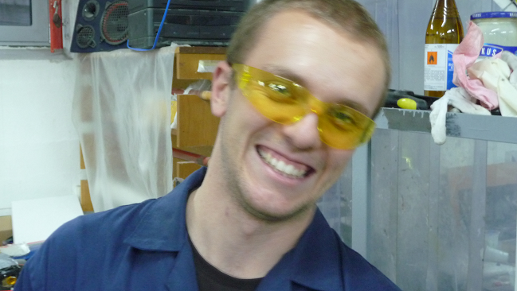
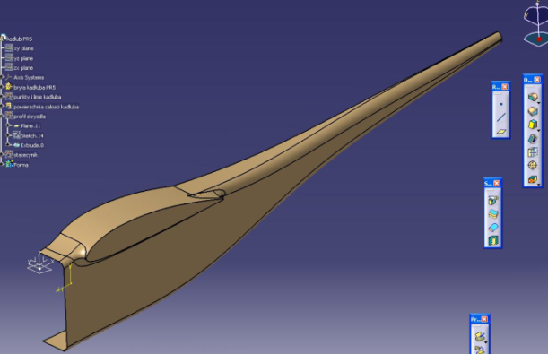
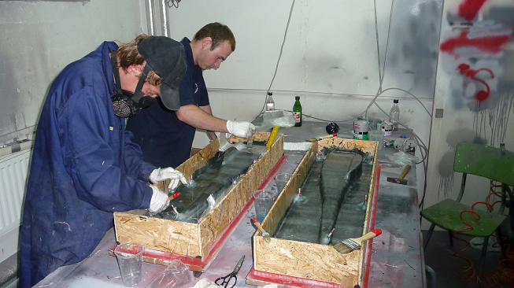
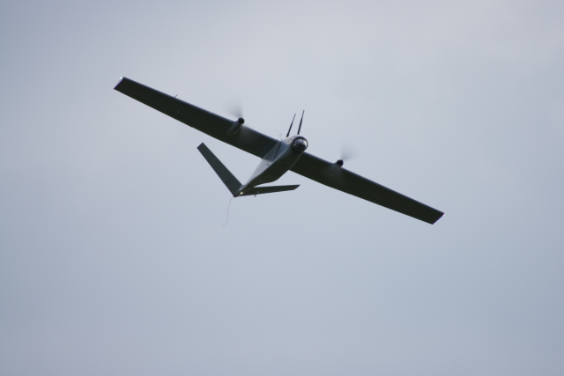
Who are we?
Our group is a growing and active students organization aiming to make ideas fly…
…starting from sketches and calculations …
…we work our way out…
Rzeszow
University
of Technology
…until, finally creating airworthy
prototypes

Slide 3
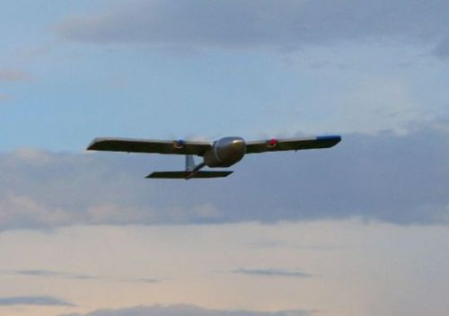
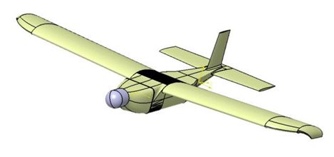
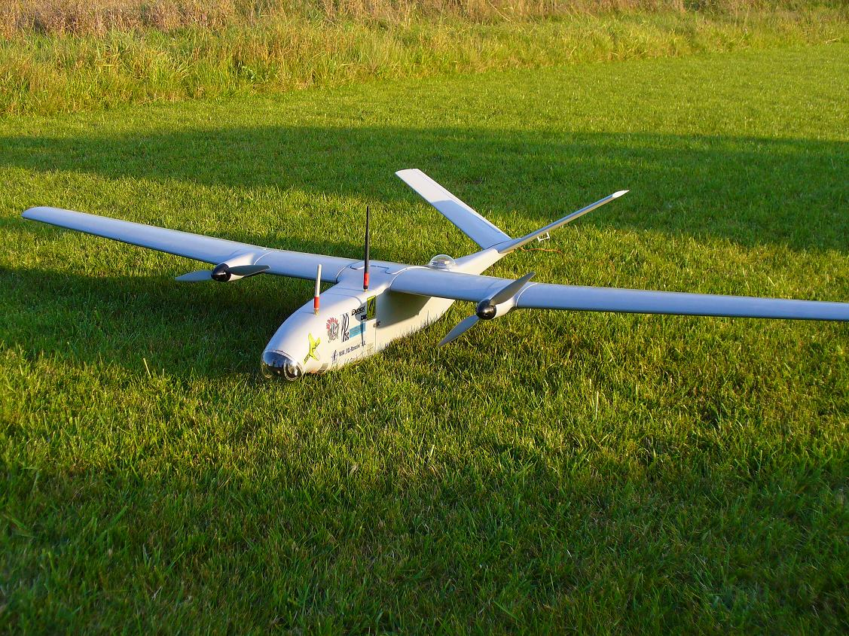
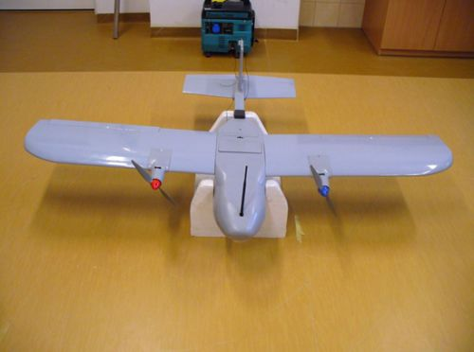
Experience
Since 2006 we have been working on the project of
UnmanedAerial Vehicle designed for autonomus patrollig
PR-3 Struś
PR-1 Szpion
Rzeszow
University
of Technology
PR-2 Gacek
PR-5 Wiewiór

Slide 4
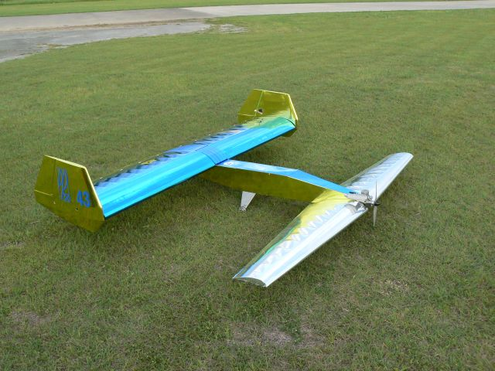
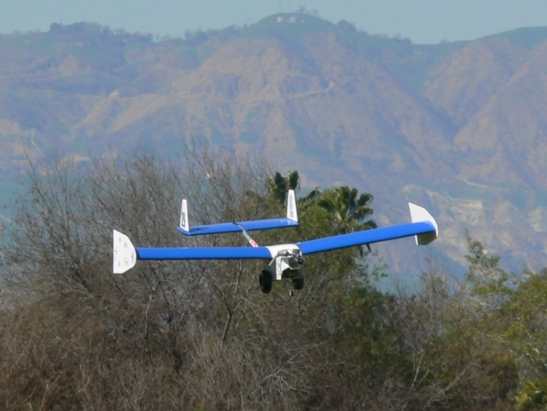
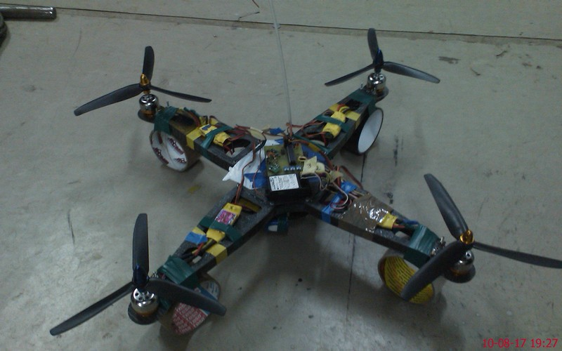
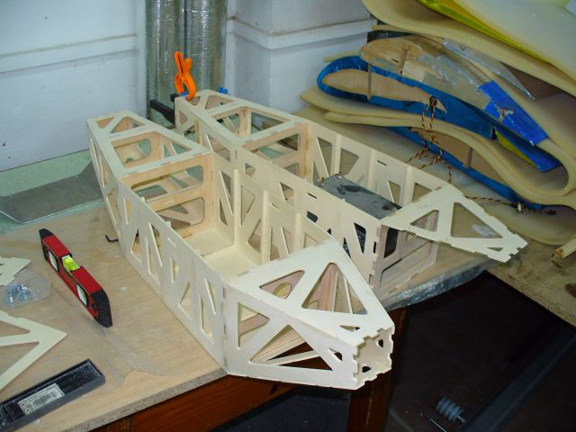
Parallel projects
Since 2009 part of our group
takes part in
SAE Aero Design challange in USA
Cargo PR-6
Some of us do separate. individual projects…
Cargo PR-4
Rzeszow
University
of Technology
PR-7 Qadrocopter
Cargo PR-8

Slide 5
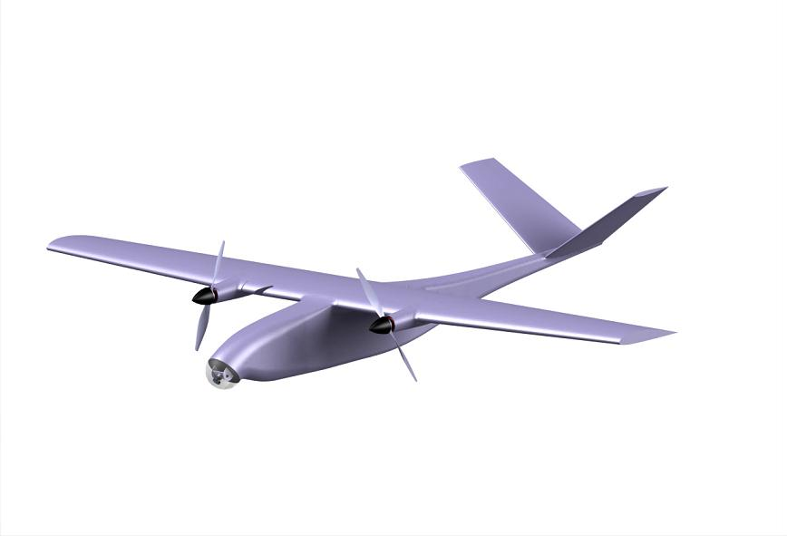
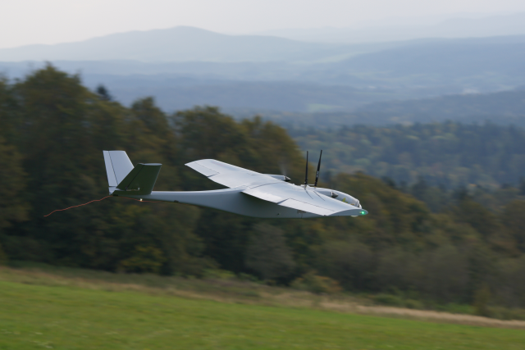
UAV PR-5+ „Wiewiór+”
Specifications:
Wing span
Length
Height
Operational weigth
Min. speed
Max. rate of climb
Max. speed in level flight
Max. flight duration
2.14 m
1.80 m
0.35 m
5.5 kg
10.5 m/s
6.5 m/s
26.3 m/s
50 min
Rzeszow
University
of Technology

Slide 6
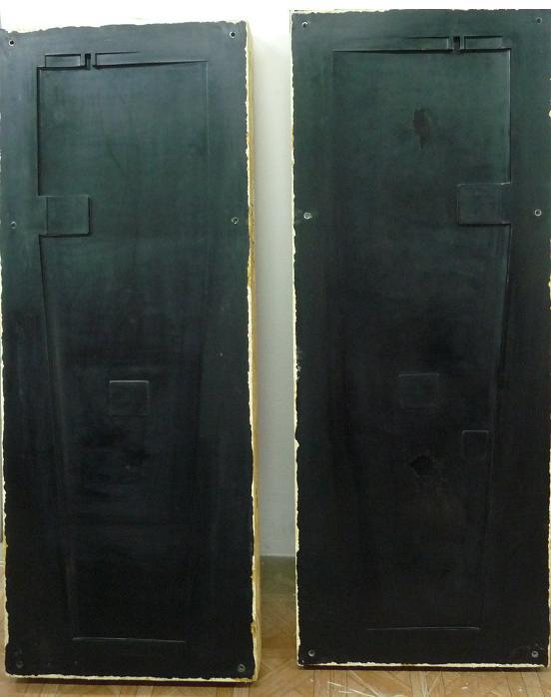
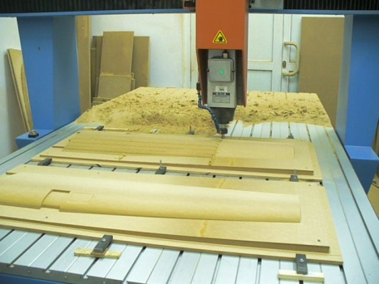
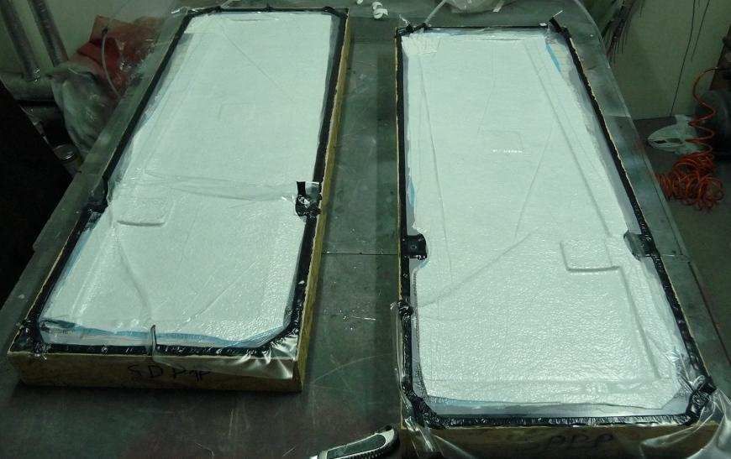
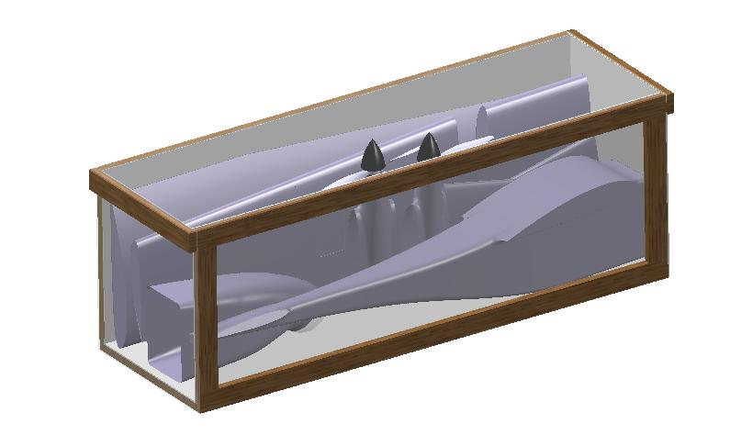
Construction
It is a fully monocoque design
We use CNC machines to create
positive moulds
Modular construction ensures
simpleness of modifications and repairs
Rzeszow
University
of Technology

Slide 7
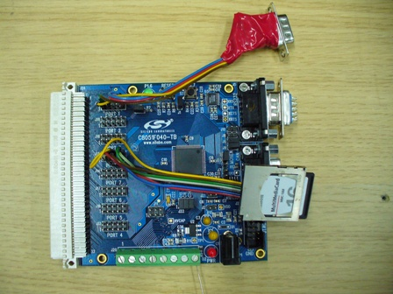
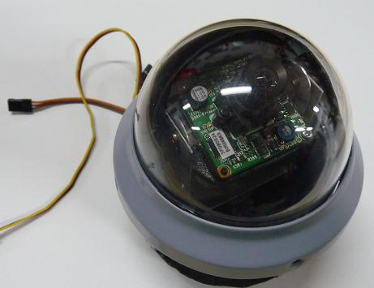
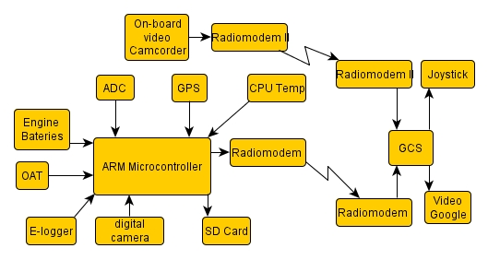
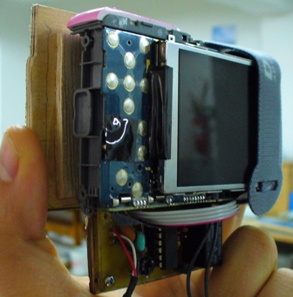
Avionics
Microcontroller
Observation system
Photo camera
Rzeszow
University
of Technology

Slide 8
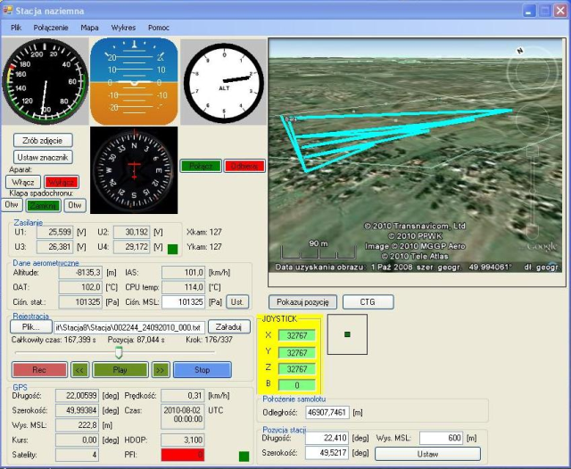
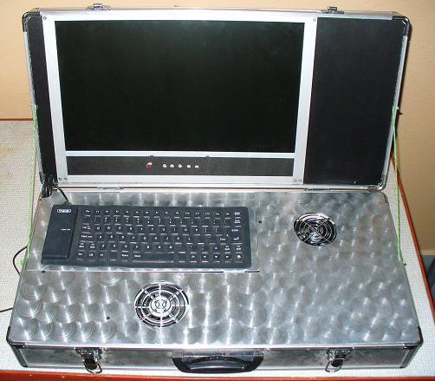
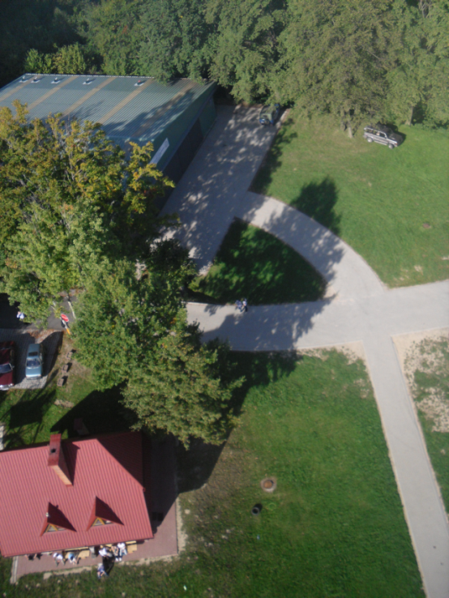
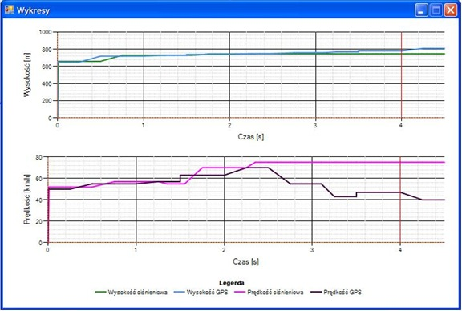
Ground Control Station
Rzeszow
University
of Technology

Slide 9
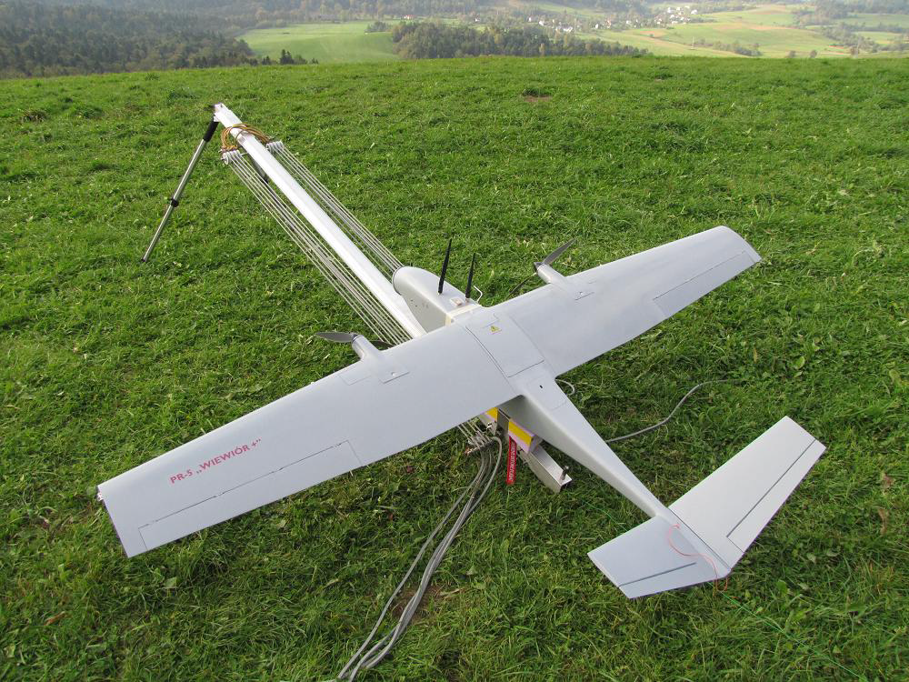
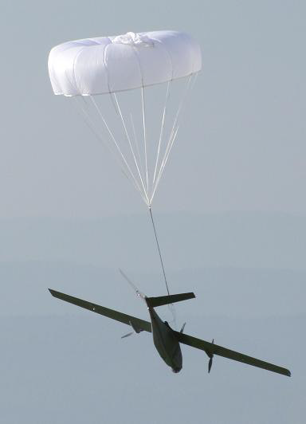
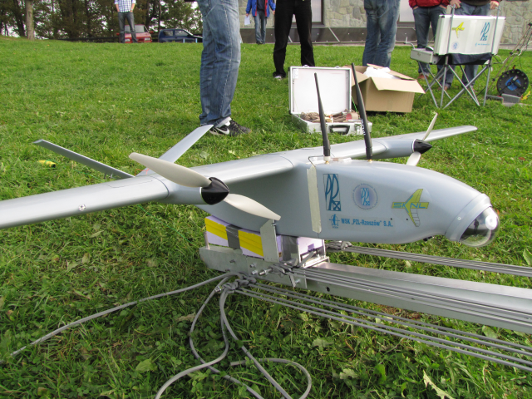
Launch & Rescue
Catapult assisted take off
Rzeszow
University
of Technology
Parachute rescue system

Slide 10
Air Cargo Challenge
INTERNATIONAL CONTEST
Design, Build and Fly!
3rd Edition - Stuttgart, Germany,
11 – 15 August 2011
LIFT AS MUCH PAYLOAD AS IT IS POSSIBLE
Design cargo model airplane with given
motor and empty weight restriction
Sponsors
Rzeszow
University
of Technology

Slide 11
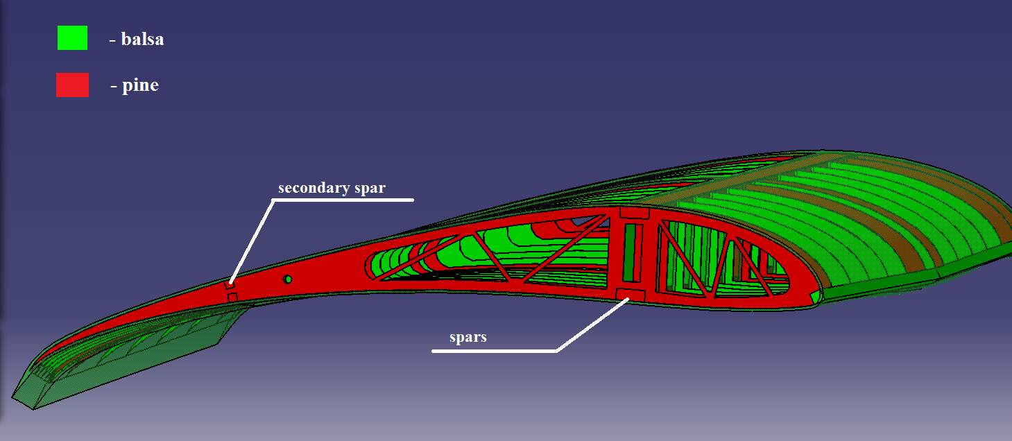
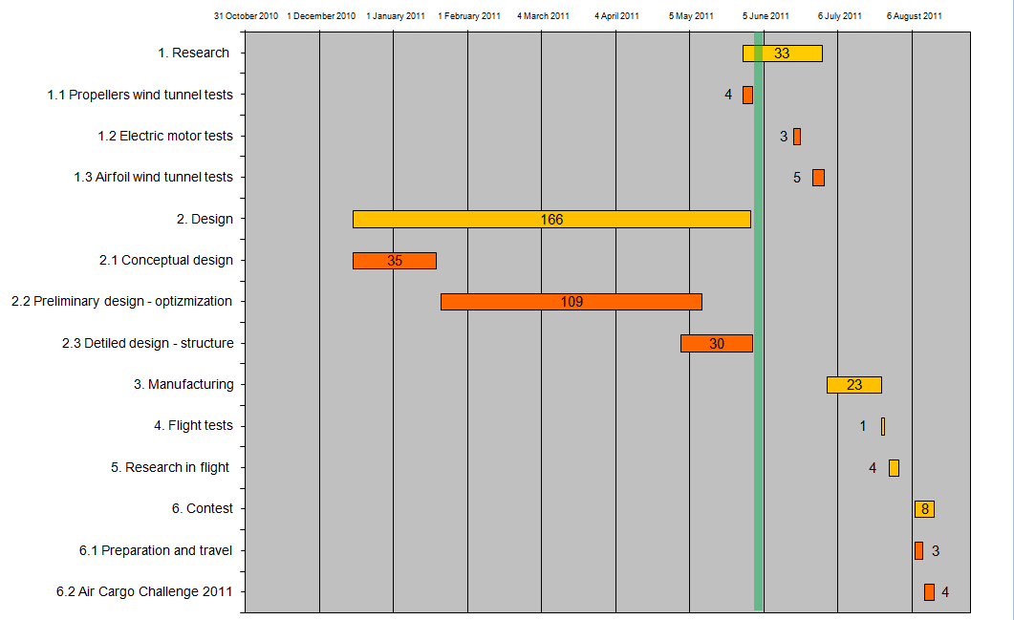
Air Cargo Challenge
Rzeszow
University
of Technology

Slide 12
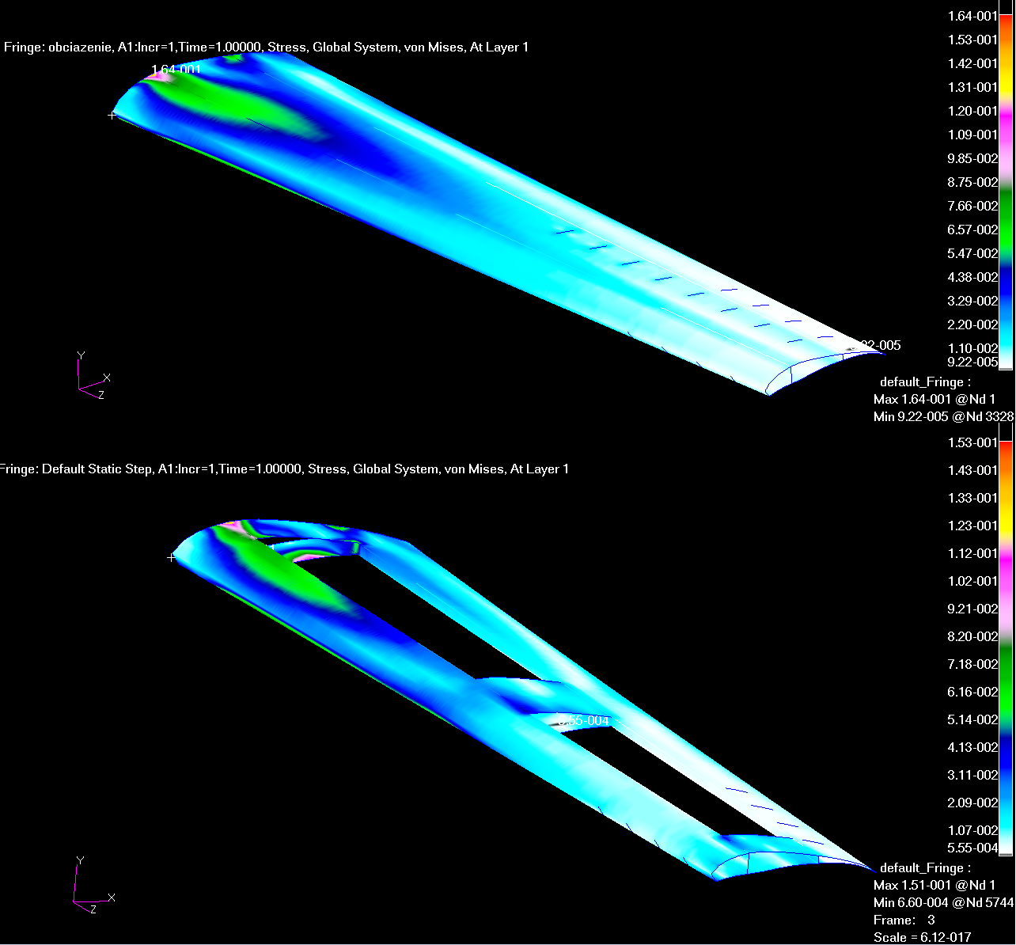
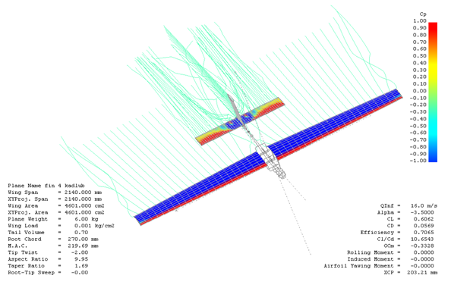
Air Cargo Challenge
Rzeszow
University
of Technology

Slide 13
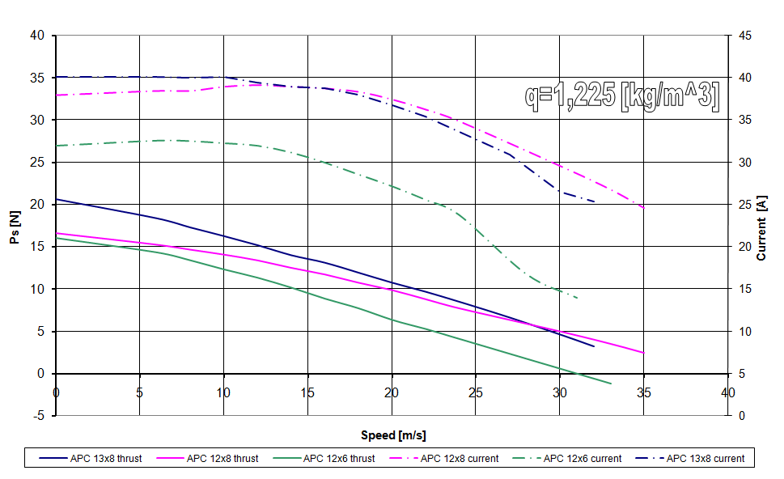
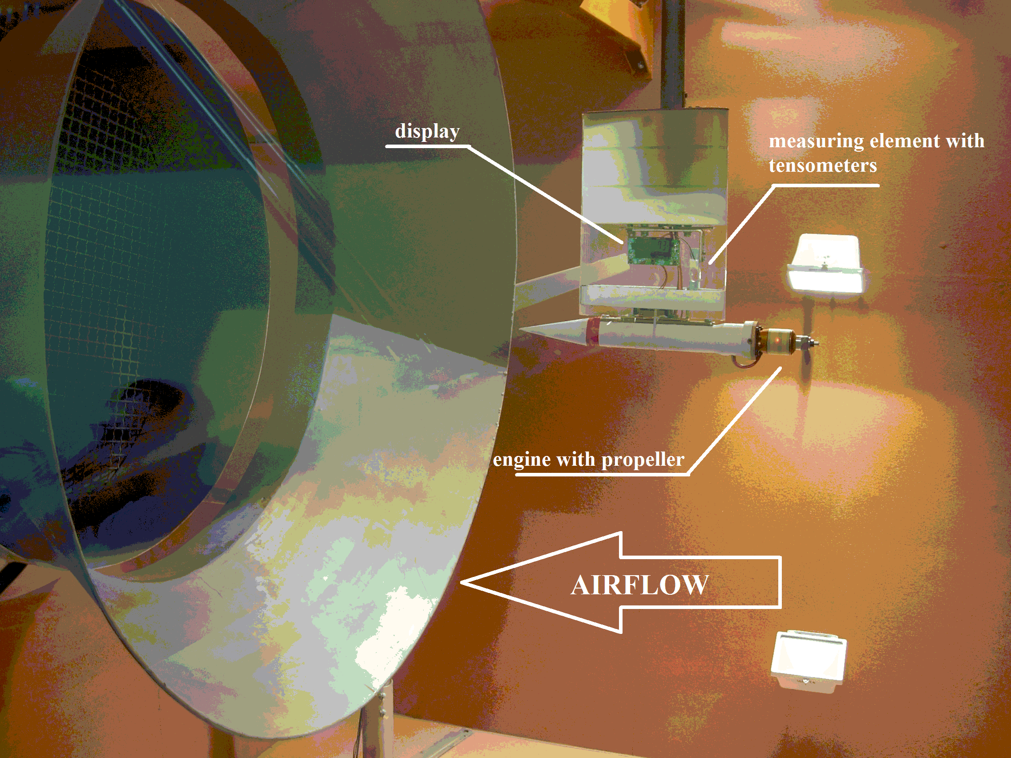
Air Cargo Challenge
Rzeszow
University
of Technology

Slide 14
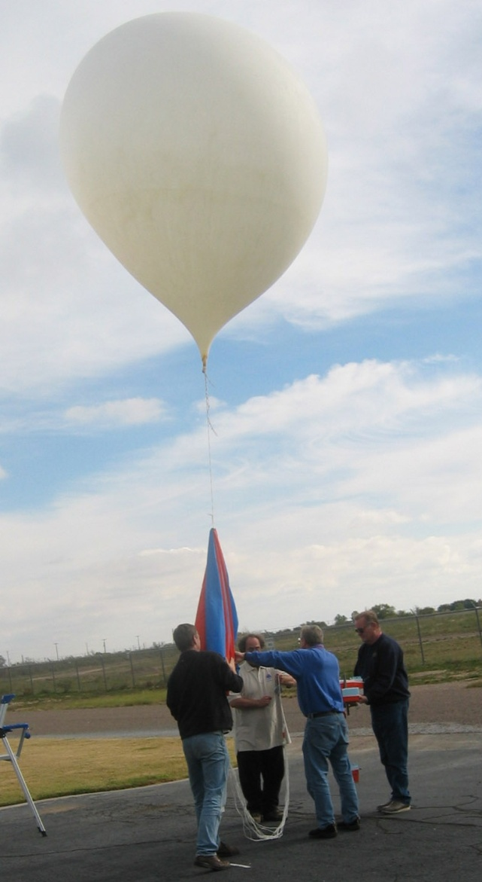
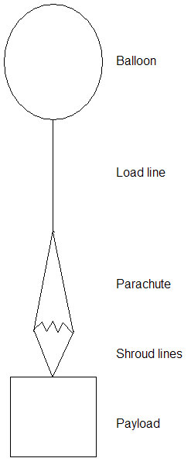
Transmitting balloon
Specifications:
Load capacity: 3 kg
Expected height: 35 km
GPS transmission
Pressure registration
Temperature registration
Photos capture
Sponsor
Rzeszow
University
of Technology

Slide 15
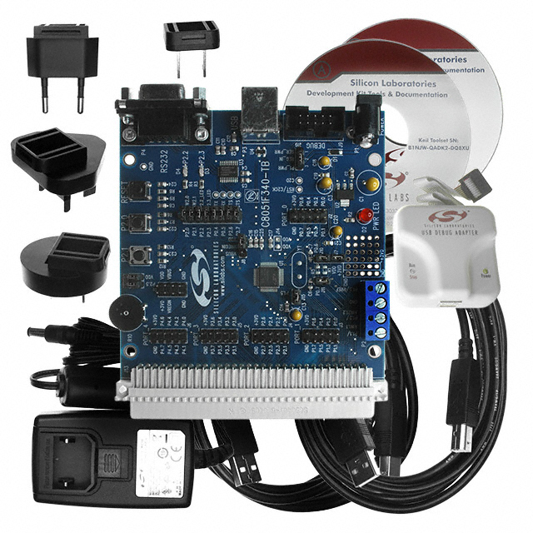
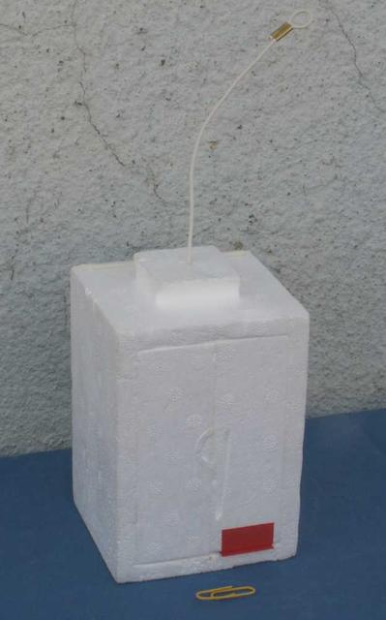
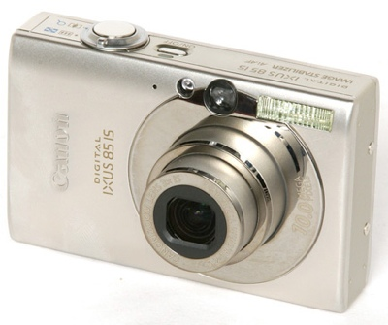
Transmitting balloon - components
Rzeszow
University
of Technology

Slide 16
Other activities (last year)
Company visits (PZL Mielec, WSK PZL Rzeszów),
Lectures (Pratt&Whitney, Hamilton Sundstrand),
Seminars (AutoCAD, Catia, Matlab),
Workshops (English phraseology for pilots),
Support and cooorganization (Politechnika Dziecięca, Dzień Odkrywców, Małopolski Piknik Lotniczy),
International Events (Workshops, Congresses, Cultural Exchanges, Symposias)
Rzeszow
University
of Technology

Slide 17
Why?
SCIENTISTS
AVIATION VALLEY
PRz
INDUSTRY
STUDENTS
ORGANIZATIONS
Rzeszow
University
of Technology
UNIVERSITY

